Slide 1
Housekeeping:
Today:
Encapsulation, private/protected items, setting and getting attributes.
Inheritance – basic theory, overload/ride,

Slide 2
Overloading and Encapsulation

Slide 3
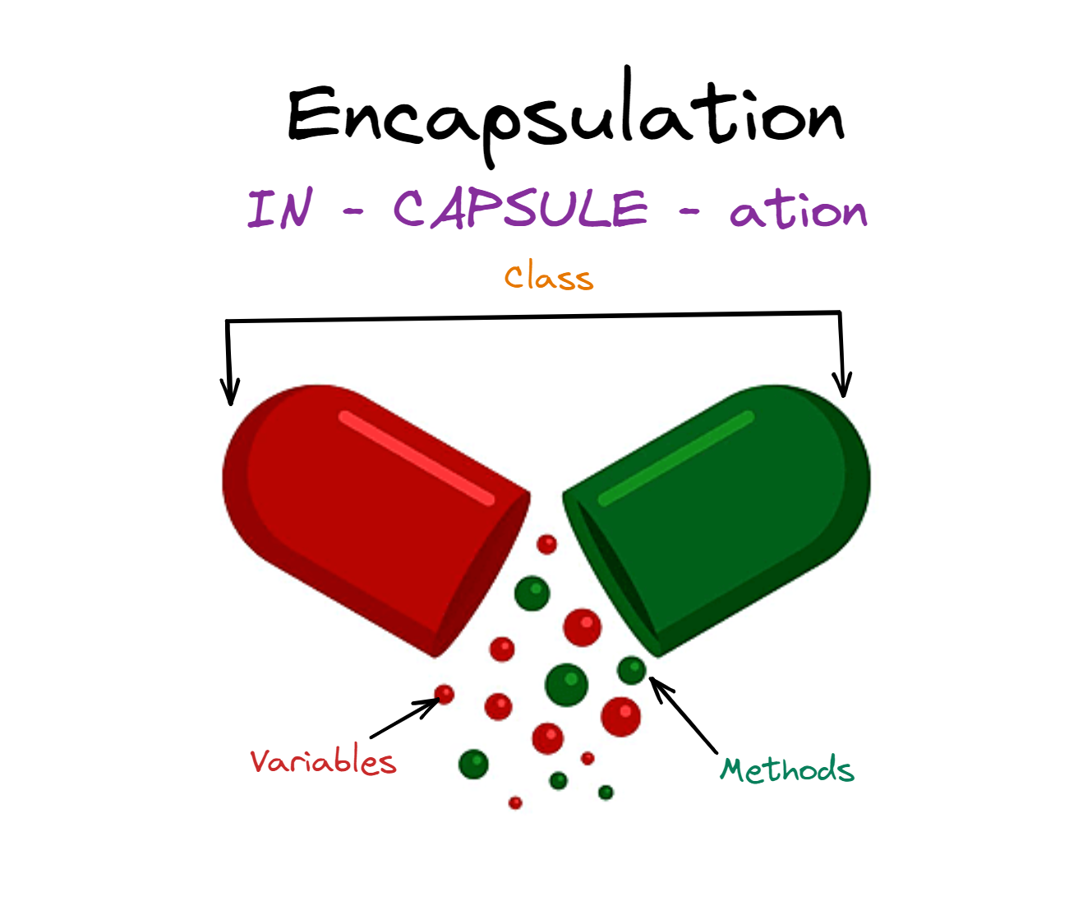
What is Encapsulation?
Encapsulation is a fundamental concept in object-oriented programming (OOP).
It involves bundling the data (attributes) and methods (functions) that operate on the data into a single unit, typically called a class.
The class serves as a blueprint for creating objects, providing a way to control access to the data and methods.
In layman’s language, we want to interact with the object as a whole, not the parts of that object.

Slide 4
We’ve Been Encapsulating!
When we use the basic objects or common other ones (e.g. dataframe) we are used to this as a concept.
When we interact with a dataframe we “ask” the dataframe to do things for us.
Get this row, give the length, give the info….
For example, if we want to take the mean of a column in a dataframe:
We don’t want to loop through each item and calculate the average manually.
We want to use the dataframe’s own ability, mean(), to do it for us.
The “main” item of concern is the object, not it’s innards.

Slide 5
Why is this important?
Encapsulation is one of the underlying ideas that makes OOP work.
We want to rely on each object to “do” things itself.
The object is able to manage the stuff inside of it.
This makes our code more portable – objects are not dependent on other things.
From the DF.mean() example, the DF isn’t reliant on some other class.
Some of the main benefits are:
Controlled Access: Access to data and methods is controlled through access modifiers (public, private, protected).
Modularity: Encapsulation promotes a modular design, making it easier to manage and update.
Security: Protects the internal state of an object, preventing unintended modifications.

Slide 6
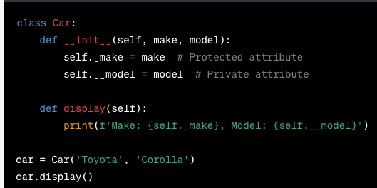
Controlled access
We can control access to the attributes and methods inside of our classes at declaration time.
Underscores denote the scope (where something is available):
Public: Accessible from anywhere outside the class. This is default.
Private: Accessible only within the class, denoted by a double underscore (__).
Protected: Accessible within the class and its subclasses, denoted by a single underscore (_).

Slide 7
But… How do We Get to It?
Hidden attributes obviously aren’t able to be accessed or changed from the outside.
We obviously might need to access them.
What do we do?

Slide 8
Accessing Variables
Basic dot notation:
Attributes inside an object can be accessed through dot notation: object.attribute
Setter and getter methods.
The ‘classic’ way to access internal variables is through setter and getter methods.
These simple methods serve to either return a value, or update it.
The attribute itself is hidden, or protected, from the outside, only these methods access it.
Get entry and set entry:
Get and set entry are more hidden methods, like __str__.
We can write methods that are automatically called when using dot notation.
Can then define a ‘property’ that ties the variable to the methods.

Slide 9
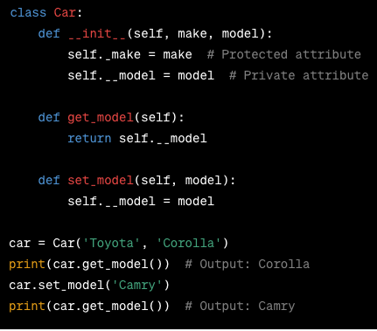
Setter and Getter
Setter and Getter methods are methods to access internal attributes of a class.
These methods allow us to control access to the attributes.
Private attributes can’t be modified directly, but these methods can do it for us.
Logic can be included to manage access:
Setters can have checks for valid data.
These provide us with our interface with the object.

Slide 10
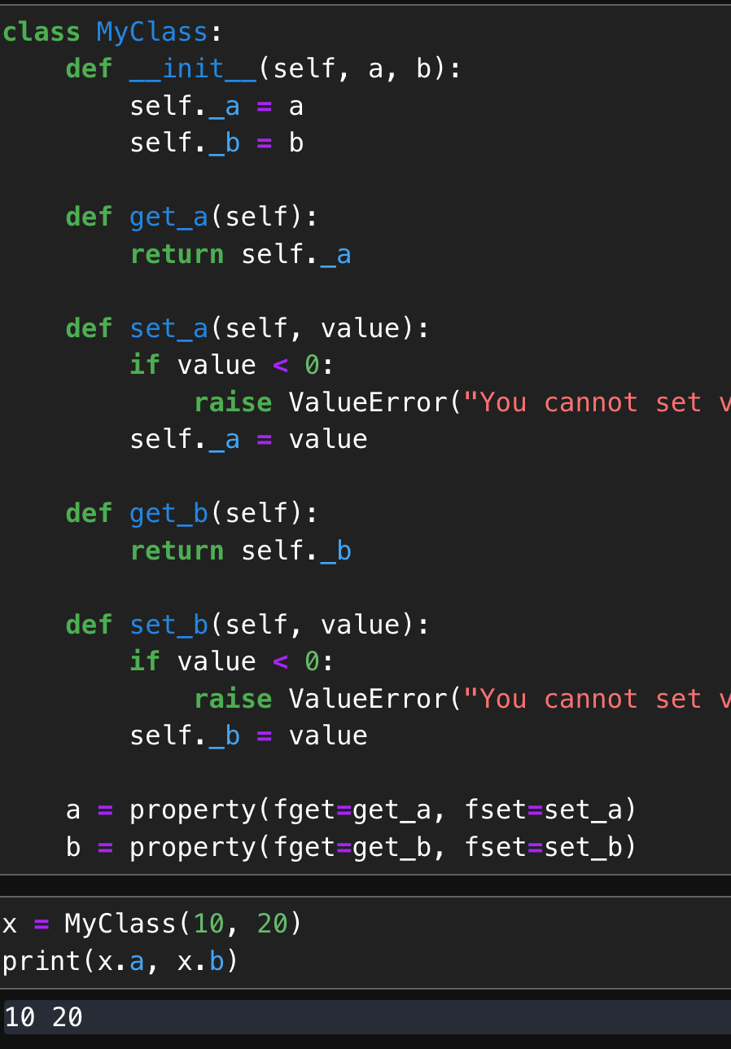
Get it and set it!
The ‘pythonic’ way to do this is to use properties as needed:
A property is an attribute, that python applies set/get/del methods to.
Effectively ‘builds in’ rules of an attribute.
Set/get methods are run transparently when the object is set/got.
Can also be triggered using decorator - @property.
Decorators wrap a function with other functionality.
Like the static method decorator.
Abstract away the usage rules of an object from an end user.
User doesn’t need to do anything different from a normal attribute.

Slide 11
Properties are a Win Win
Properties, especially, allow us to get a win-win:
Users get simple, consistent, abstract access to attributes.
Developers can control privacy and implement controls in code.
On small things it matters little, as code bases grow, the advantages grow.
Never need different syntax to access an attribute (set/get).
Validity checks can be built into the properties, preventing error.
Security and access control can be controlled, to the extent required. (E.g. fine grain authentication).
More abstract interface for users – they just get/set, logic is in the class.

Slide 12
Overriding and Overriding
One tangible application of encapsulation is the overloading of operators.
We can redefine what many of the basic operations mean in the context of our objects.
E.g. we have used str to define how objects print.
We can do this for several things:
Math operations: +, -, /, *
Boolean logic: equals, less/greater.
Other common things: len, str
This means that we are again offloading the logic to the class itself.
Adding two strings makes sense as concatenation. We don’t need to care about the how.

Slide 13
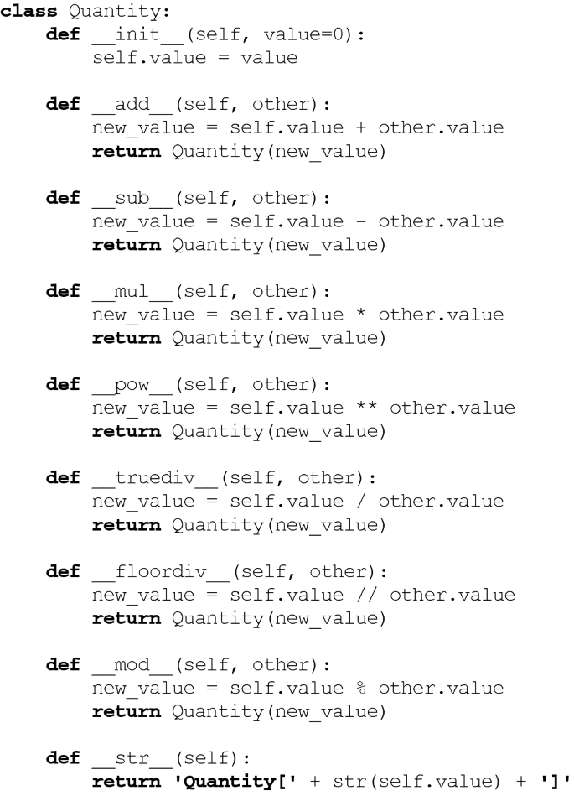
Operator Operations
Each overload is defined by some function name.
There’s a link in the notebook to a list.
The ”magic” ties these to the operator or function.
The return expectation is defined by the operation.
E.g. logic requires T/F, add/sub requires an object.
The “other” is standard for the thing we are using.
Self is the current object.
Other is the other one.
A + B -> A is self, B is other.
There are few limits, we just need to make it make sense.

Slide 14
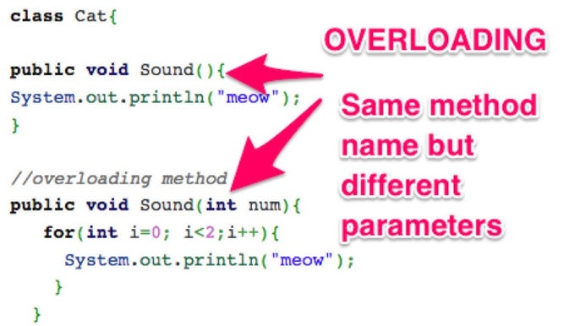
Overload vs Override
The terms overload and override refer to similar things.
Overload – a method has more than one signature. The correct one is based on input.
This is not allowed in python – every function is an obj, and they can’t have the same name.
E.g. different methods that can accept different argument types – e.g. “calculate tax” method that can take in different income forms as input – t4, t1, etc… In python you don’t really need this.
Override - a method in a parent class is overwritten in a child class.
The way a function works is defined/redefined in a child class. Adapt performance to the child.
E.g. length, str, add, etc…
Operator Overloading - Operators exist in parent class (high), and are implemented in children.
Why isn’t it called operator overriding? Different languages and programmers suck at person language.

Slide 15
Python Notes
The rules of encapsulation are less strong in Python than other languages.
The private stuff is not truly private, just hidden away.
This is a design choice by Python.
The implementation of some things like setters and getters will change.
There is another concept called decorators that will change it a bit.
The concept won’t change, only the implementation, to be more “Pythonic”.

Slide 16
Goals and Uses
Guidelines:
Use encapsulation to hide the internal implementation details of a class.
Follow consistent naming conventions for attributes and methods.
Limit direct access to attributes, encourage the use of getter and setter methods.
Overload reasonable operators to make things make sense.
Goal:
We want our classes to work like the ones we use.
We have an API that we can reference (like the pandas docs) which details what the class can do. Users don’t need to care how or worry about the details.

